Slide 1
DDBMS-Hadoop
Mazharul Islam
Lecturer
Dept. of CSE
ICE, Khulna

Slide 2
ٱلسَّلَامُ عَلَيْكُمْ
(Peace be upon you)

Slide 3
What we’ll learn today
Hadoop
MapReduce
HDFS
Hadoop Architecture
Hadoop Ecosystem
Apache Hive
Apache pig
Mahout
Apache Hbase

Slide 4

What is Hadoop ???

Slide 5
Open
Source software framework
Based on JAVA
Store any kind of Data
Hadoop
Storage for Big data
Distributed Processing
Distributed Storage

Slide 6

Hadoop Architecture

Slide 7
Map Reduce
HDFS
YARN Framework
Common
Utilities

Slide 8

Map Reduce

Slide 9
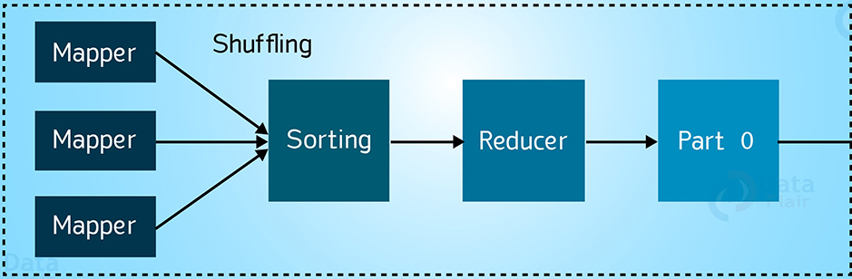
Based on YARN Framework.
Main job is Parallel Processing
Two functions. i) Map(); ii) Reducer();
HDFS
Replication

Slide 10
Master-Slave Tracker
Master Job Tracker
Slave Task Tracker
1. Managing resources
2. Scheduling task
3. Monitoring task
1. Executes the task
2. Provide task status
one master many slave

Slide 11

Master
Slave_1
Slave_2
Slave_3

Slide 12

Hadoop Distributed File System (HDFS)

Slide 13
1. Work based on GFS (Global File System)
2. Data Replication
3. Data Storing
4. Data Access Permission

Slide 14
HDFS Architecture

Slide 15
Name Node : Stores the Metadata ( data about data )
As example, file name, file size, file location and everything about data. It also manages the data nodes.
2. Data Node: Stores the actual data. Main data is divided into many blocks and stored at the different data nodes. Something data are deleted and replicated according to the system’s need.

Slide 16

How Hadoop works with these Daemons?

Slide 17
Data
H
D
F
S
H
D
F
S
Map
Reduce
Data
Program
Master

Slide 18

Hadoop Ecosystem

Slide 19
Hadoop Ecosystem is nothing but a Platform or Framework Which is introduced to solve Big-data problems
Don’t confused !!!
It is neither a programming language nor a service like SQL, RDBMS
There are six components in ecosystem, We have already discussed three of them. Lets discuss the other there.

Slide 20

APACHE

Slide 21
Hive is an Open-Source data warehouse system for querying and analyzing large data set stored in Hadoop files.
Normally it summarize the data, query and analysis the data. It uses HiveQL i.e. HQL.
It is highly scalable

Slide 22
S
Master
S
User
Hive
Converts SQL
To map reduce job
Submit
SQL queries
S
Meta store
S
Hadoop Cluster

Slide 23

APACHE
PIG

Slide 24
User Defined Function presents in Local File System
Pig Script
i/p file in HDFS
Pig Latin Compiler
Execution of Map Reduce job
O/P file stored in HDFS

Slide 25


Slide 26
Mahout
Analytical Techniques on big data
i/p file in HDFS
Java
Libraries

Slide 27
Techniques for implementing mahout
Classification:
Logistic Regression
Naïve Bayes
Clustering:
K-means clustering

Slide 28


Slide 29
CLIENT
Z
O
O
K
E
E
P
E
R
Hmaster
Region
Server
Region Server
Libraries
HDFS

Slide 30
For more please visit
https://www.databricks.com/glossary/hadoop
https://data-flair.training/blogs/hadoop-reducer/
https://www.linkedin.com/pulse/hadoop-hdfs-yashwanth-m-b
https://waytoeasylearn.com/learn/hdfs-architecture/

Slide 31
Thank you

